Slide 1


The
Road
Warrior
The Profitero Data Alchemists Architectural Kata by O'Reilly, September 2023
The next generation online trip management dashboard

Slide 2




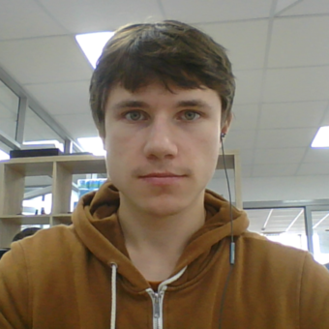

Profitero Data Alchemists
Arkadzi Salnikau
Denis Klimenko
Dmitry Trofimov
Ilya Hardzeenka
Oleg Zubchenko
Notes:
Hi everyone! We are the Profitero Data Alchemists team. Together, we have been working as software architects at Profitero for over two years, and we are thrilled to participate in this competition. Allow us to share the journey of our architecture from its inception.

Slide 3




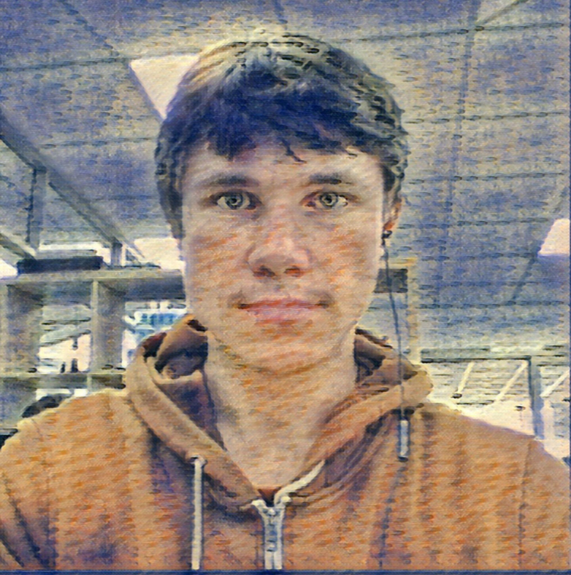
Profitero Data Alchemists
Arkadzi Salnikau
Denis Klimenko
Dmitry Trofimov
Ilya Hardzeenka
Oleg Zubchenko
Notes:
Hi everyone! We are the Profitero Data Alchemists team. Together, we have been working as software architects at Profitero for over two years, and we are thrilled to participate in this competition. Allow us to share the journey of our architecture from its inception.

Slide 4
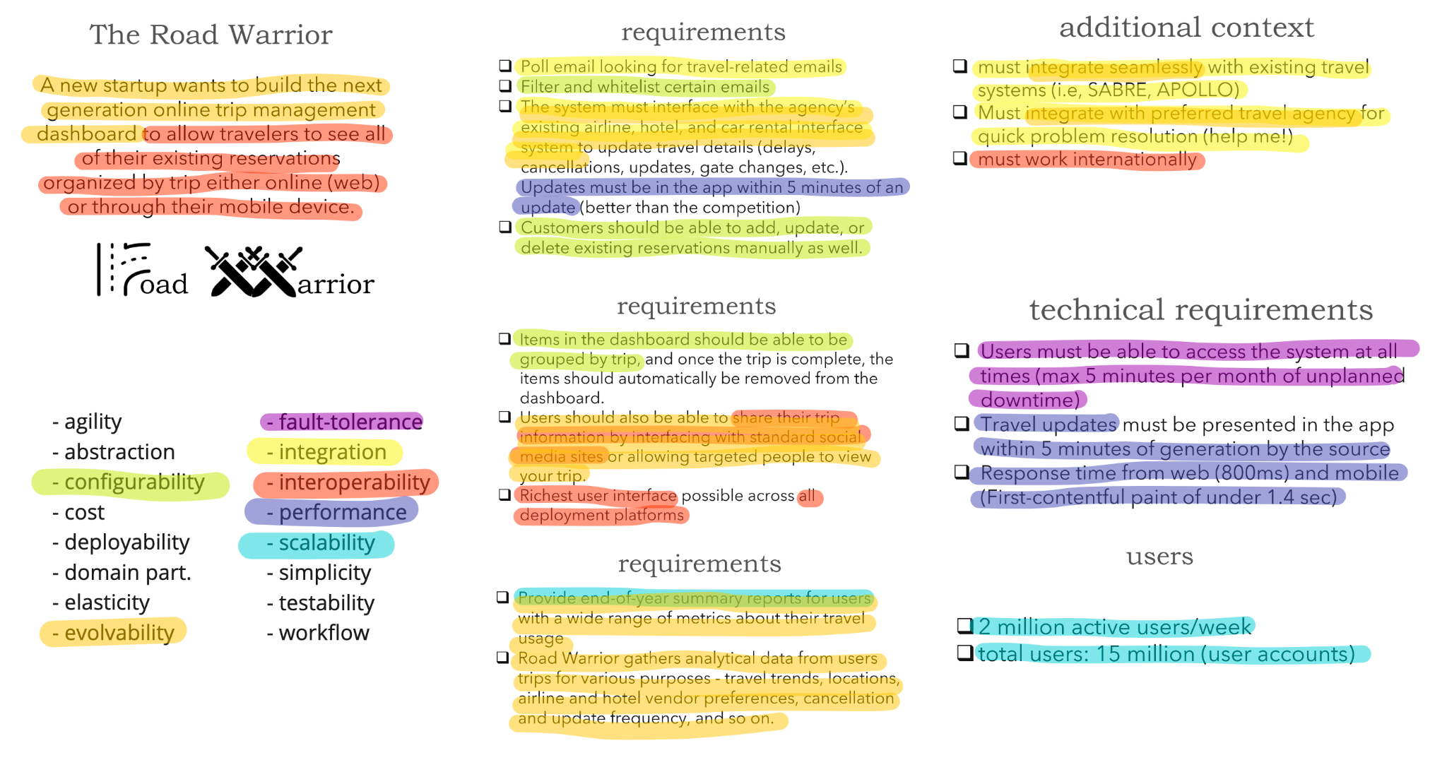
Requirements analysis
Way we analyzed the requirements
Notes:
It all started from this picture, where we dived deep into the requirements analysis. Picture this: our entire team gathered around a shared virtual whiteboard on Miro. We meticulously mapped out how each of the given requirements aligned with various architectural characteristics. Simultaneously, we identified the essential components, functions, and features that needed to be integrated into our architecture. We carefully examined their interconnections and relationships.
With a comprehensive understanding of all the details and nuances, we were able to craft a 'Functional Diagram' that served as the first milestone of our architectural design.

Slide 5

Notes:
Let's look from Functional perspective.
As a traveller, I’m often drowned in plenty of reservations and I want to manage them with ease.

Slide 6

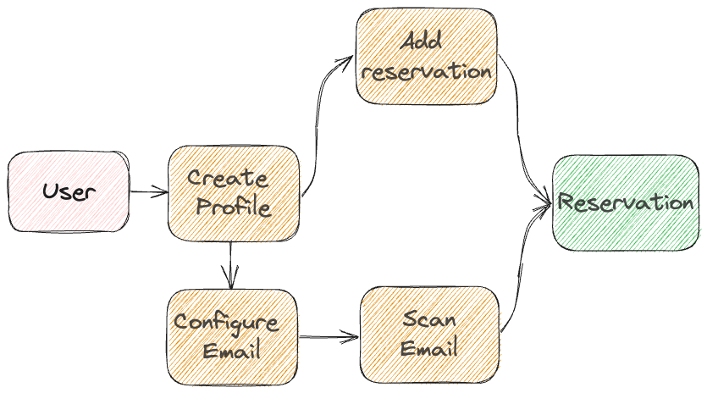
Notes:
With the Road Warrior app, all my reservations are forwarded to my dashboard from emails automatically or manually.

Slide 7

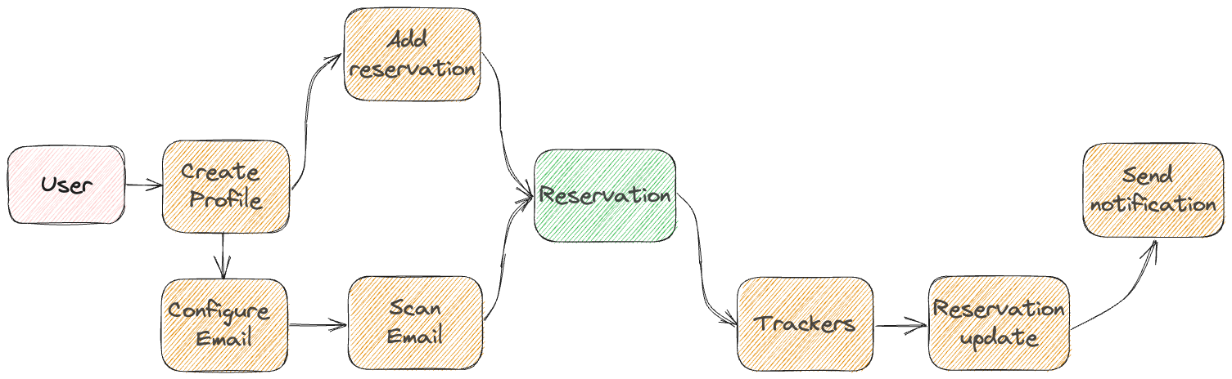
Notes:
With automatic updates of the reservation details in the app, I will never miss my flight again.

Slide 8
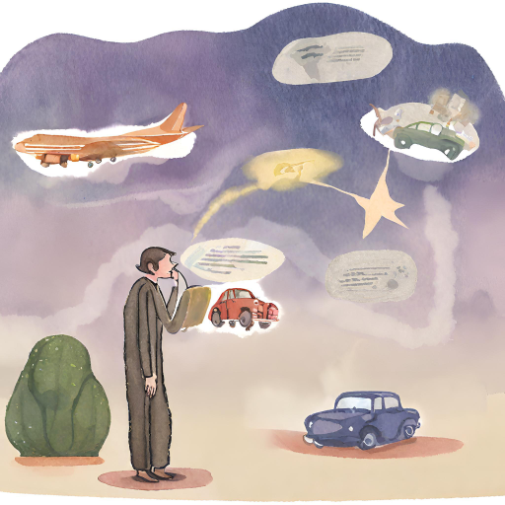
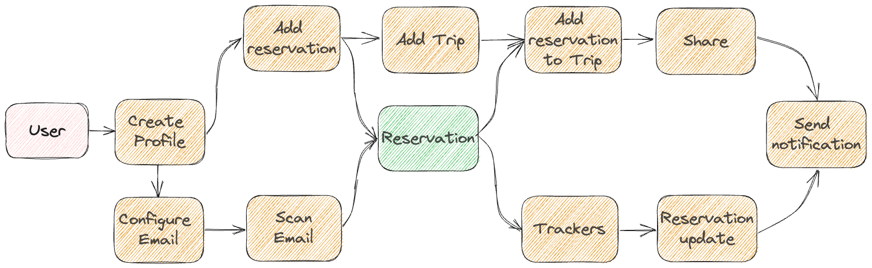

Notes:
But loads of unordered reservations in another place doesn’t help me. Grouping them into trips in the application helps me focus on what is crucial right now.
NEXT
Since the app now automatically tracks updates I can use extra time to make friends jealous by posting my trips on Facebook.

Slide 9

Our process
Notes:
Now, as we grasp the functioning of our application, it's time to dive into the creation of its technical architecture.

Slide 10

Our process
Notes:
Step one is The Context viewpoint. We use it to distribute functions across components.

Slide 11



Our process
Notes:
Step two brings us three other crucial viewpoints:
Informational one, ensuring data elements align with our components.
Operational one, confirming coverage of requested functions.
Concurrency, that is guaranteeing scalability and performance

Slide 12

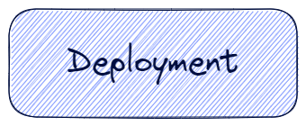
Our process
Notes:
In step three we address two new viewpoint types, namely:
Deployment, that ensures that we meet availability SLA.
Development, that addresses evolvability and aligns Context and Deployment diagrams.

Slide 13

Our process
Notes:
Finally we validate every viewpoint from security perspective and document our findings.

Slide 14
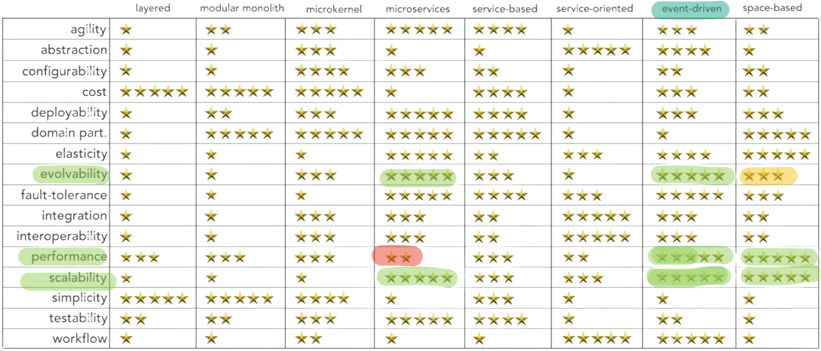
Architecture Style
Notes:
Now let's dive into the decisions we've made:
The first decision is architectural style. Since we target evolvability, performance, and scalability, we found event-driven architecture most suitable for our needs.

Slide 15
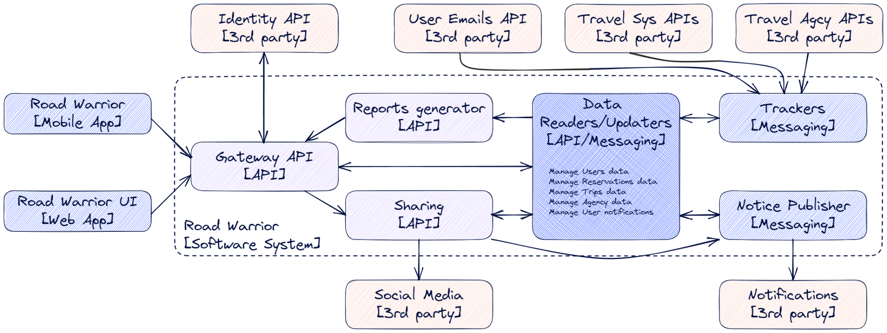
Context Viewpoint
Notes:
The second set of decisions address structure of our application:
We use API-based components to ensure responsiveness of the UI and Messaging-based components to enhance scalability of the backend.

Slide 16
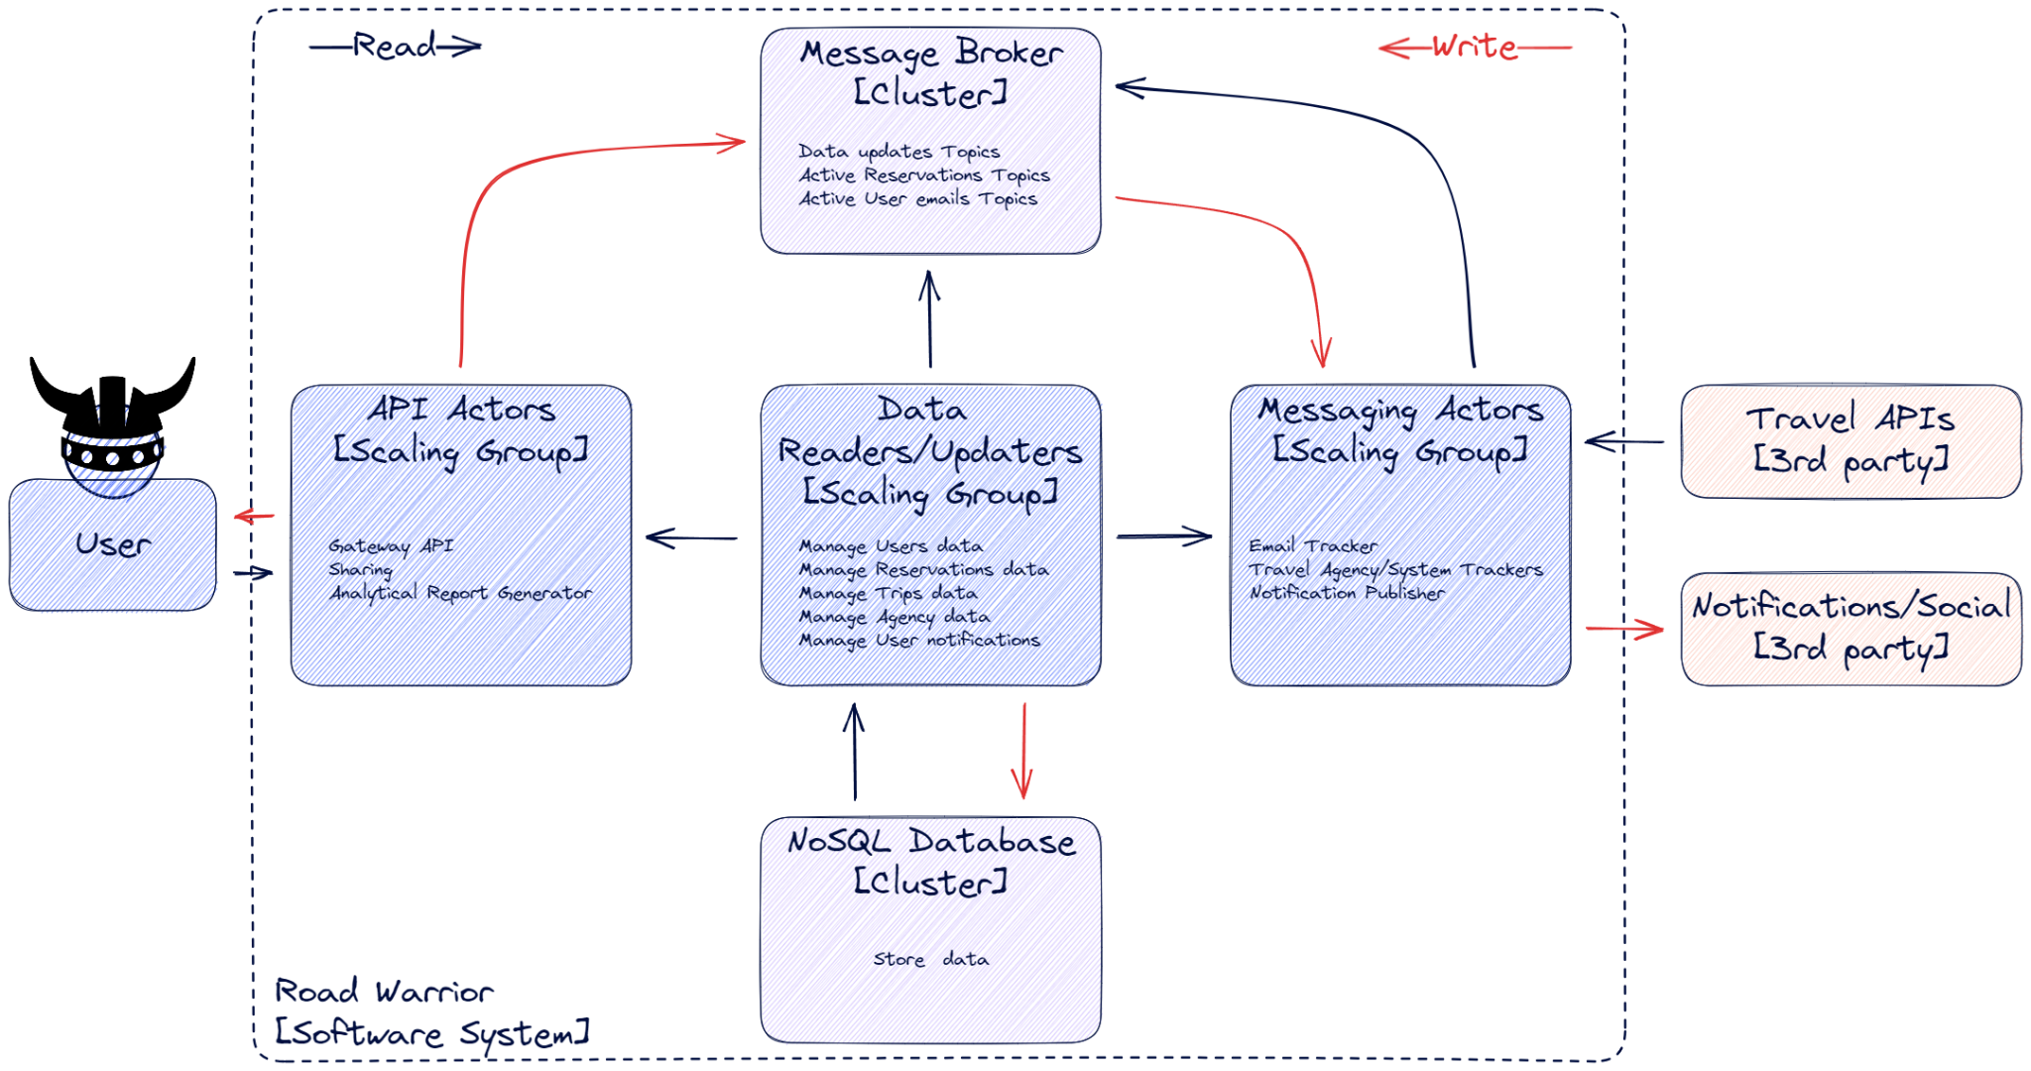
Concurrency Viewpoint
Notes:
Next we address scalability and performance by introducing scaling groups tailored to each component type.
Additionally, we've made a decision to employ topics instead of queues and use the same partitioning as in our tables. This is required is to avoid data collisions at scale.

Slide 17
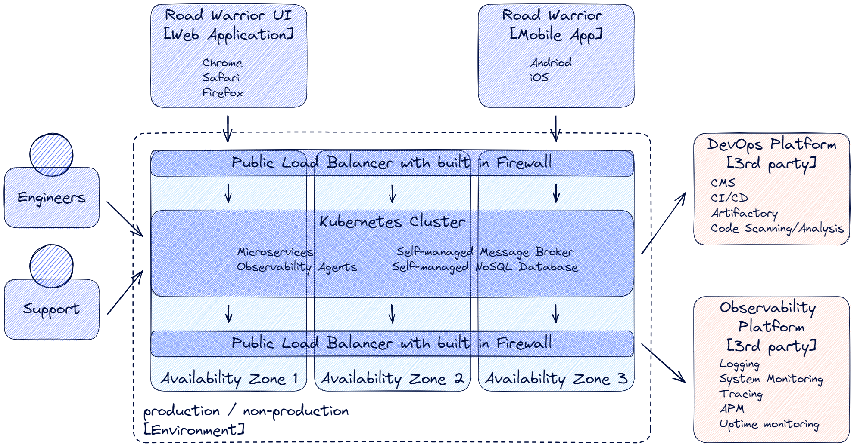
Deployment Viewpoint
Notes:
After that we decided to use Multi Zone Infrastructure for better availability and self-managed NoSQL Database and Message Broker to save our hosting costs.

Slide 18
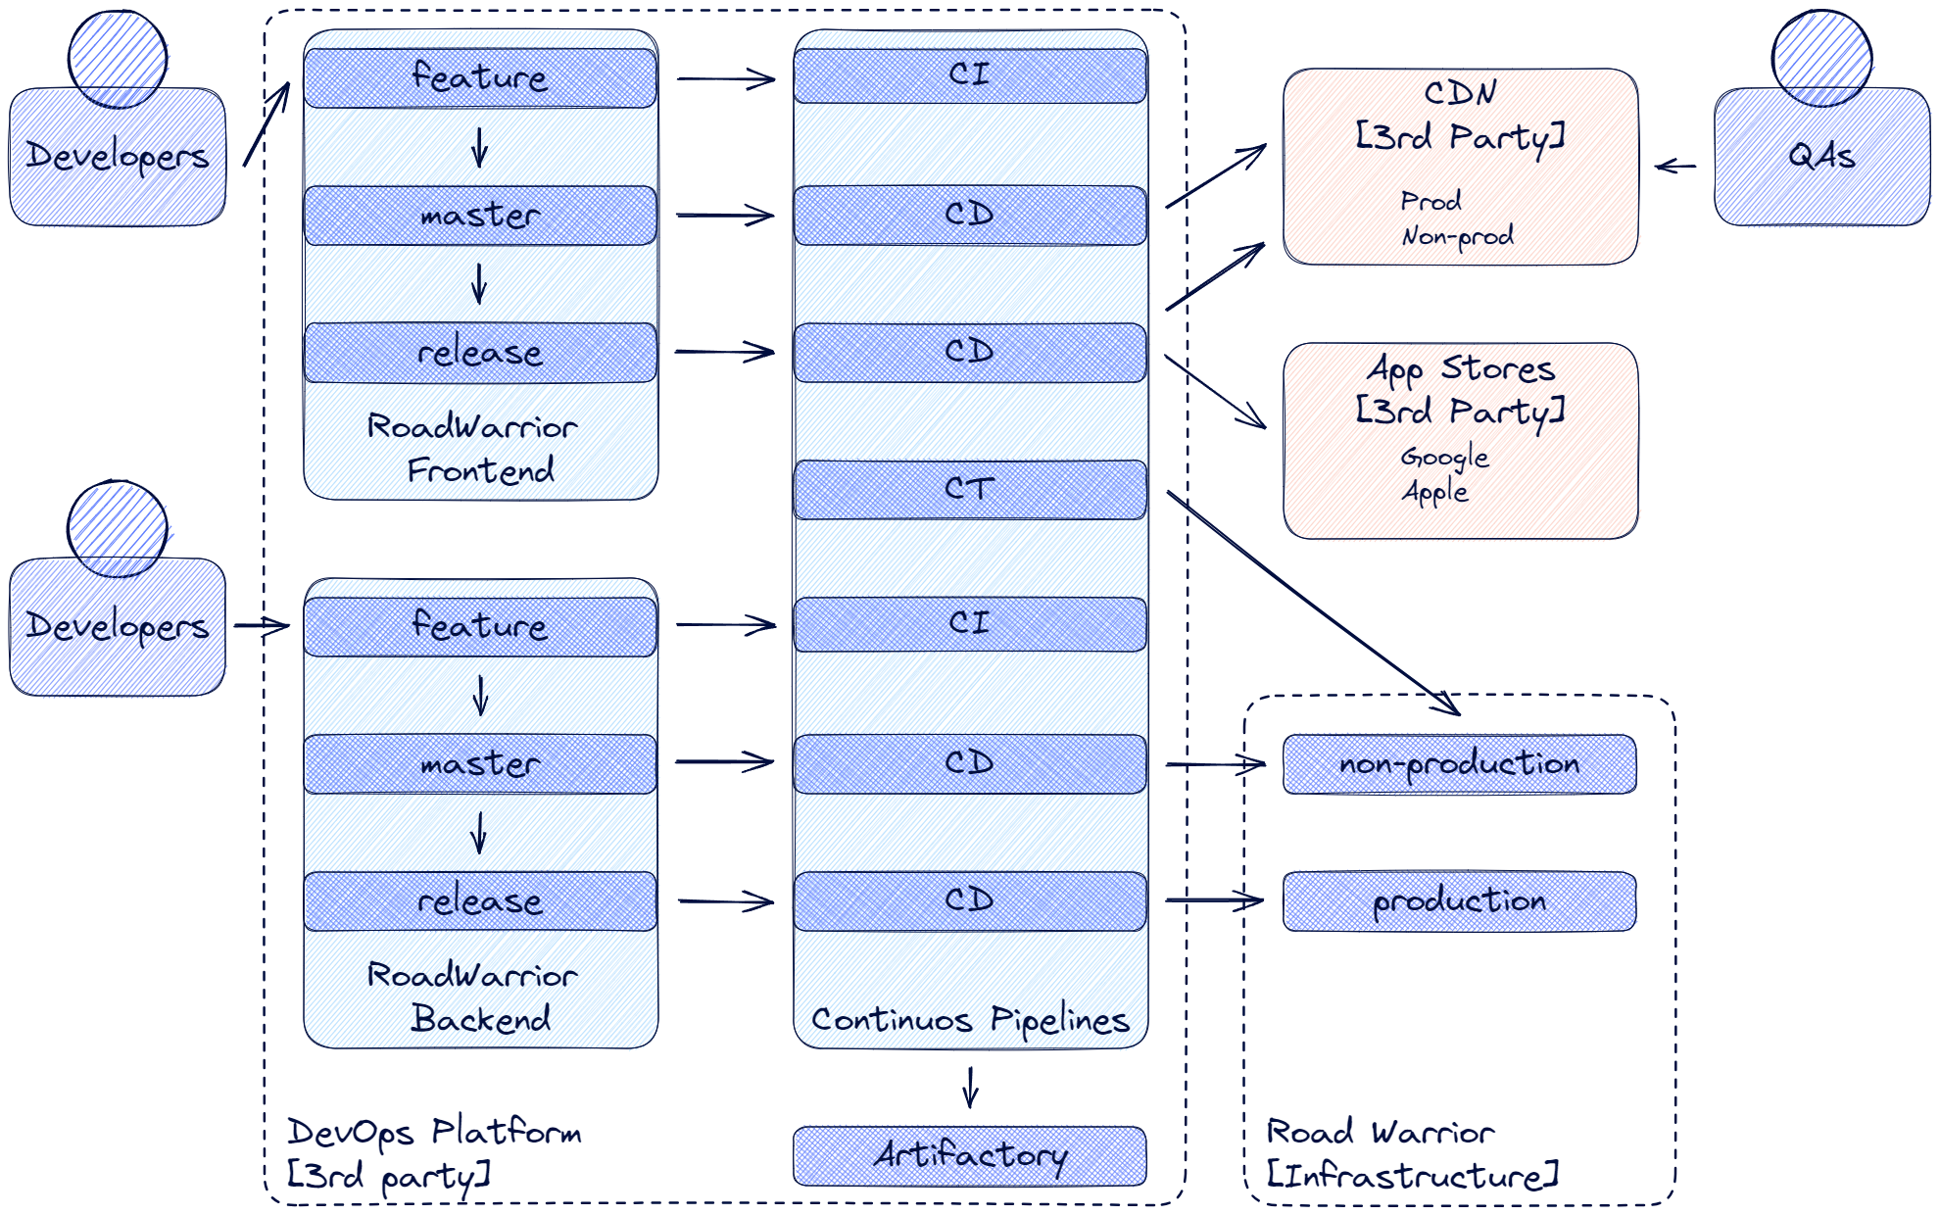
Development Viewpoint
Notes:
Finally we address evolvability by using two monorepos and following GitLab flow process.

Slide 19
What will you get
in return?
Everything
Better User Experience
Keep Data Safe
Instant Updates on Mobile and Web about your flights, hotels, and car rentals
Strong data security and privacy measures, controlled sharing of travel details
Handle Busy Times
Work Everywhere
High performance during peak usage (even on holidays and weekends), no slowdowns or crashes
No matter where you are, you can check your travel plans
Short Time to Market
Flexible architecture for rapid launch and future enhancements
Notes:
Now, Let’s emphasize what our solution offers:

Slide 20
What will you get
in return?
Everything
Better User Experience
Keep Data Safe
Instant Updates on Mobile and Web about your flights, hotels, and car rentals
Strong data security and privacy measures, controlled sharing of travel details
Handle Busy Times
Work Everywhere
High performance during peak usage (even on holidays and weekends), no slowdowns or crashes
No matter where you are, you can check your travel plans
Short Time to Market
Flexible architecture for rapid launch and future enhancements
Notes:
1) Imagine real-time updates on your reservations, accessible on both mobile and web.

Slide 21
What will you get
in return?
Everything
Better User Experience
Keep Data Safe
Instant Updates on Mobile and Web about your flights, hotels, and car rentals
Strong data security and privacy measures, controlled sharing of travel details
Handle Busy Times
Work Everywhere
High performance during peak usage (even on holidays and weekends), no slowdowns or crashes
No matter where you are, you can check your travel plans
Short Time to Market
Flexible architecture for rapid launch and future enhancements
Notes:
2) System will shine even during peak periods. No bottlenecks, no slowdowns.

Slide 22
What will you get
in return?
Everything
Better User Experience
Keep Data Safe
Instant Updates on Mobile and Web about your flights, hotels, and car rentals
Strong data security and privacy measures, controlled sharing of travel details
Handle Busy Times
Work Everywhere
High performance during peak usage (even on holidays and weekends), no slowdowns or crashes
No matter where you are, you can check your travel plans
Short Time to Market
Flexible architecture for rapid launch and future enhancements
Notes:
3) Your data is a top priority with strong security and privacy.

Slide 23
What will you get
in return?
Everything
Better User Experience
Keep Data Safe
Instant Updates on Mobile and Web about your flights, hotels, and car rentals
Strong data security and privacy measures, controlled sharing of travel details
Handle Busy Times
Work Everywhere
High performance during peak usage (even on holidays and weekends), no slowdowns or crashes
No matter where you are, you can check your travel plans
Short Time to Market
Flexible architecture for rapid launch and future enhancements
Notes:
4) Anywhere, anytime, your travel plans are at your fingertips. Our architecture keeps you connected.

Slide 24
What will you get
in return?
Everything
Better User Experience
Keep Data Safe
Instant Updates on Mobile and Web about your flights, hotels, and car rentals
Strong data security and privacy measures, controlled sharing of travel details
Handle Busy Times
Work Everywhere
High performance during peak usage (even on holidays and weekends), no slowdowns or crashes
No matter where you are, you can check your travel plans
Short Time to Market
Flexible architecture for rapid launch and future enhancements
Notes:
5) Our agility means swift launches and continuous improvements, keeping you ahead of the game.

Slide 25
Thank You!
Notes:
Thank you for your attention.

